Slide 1

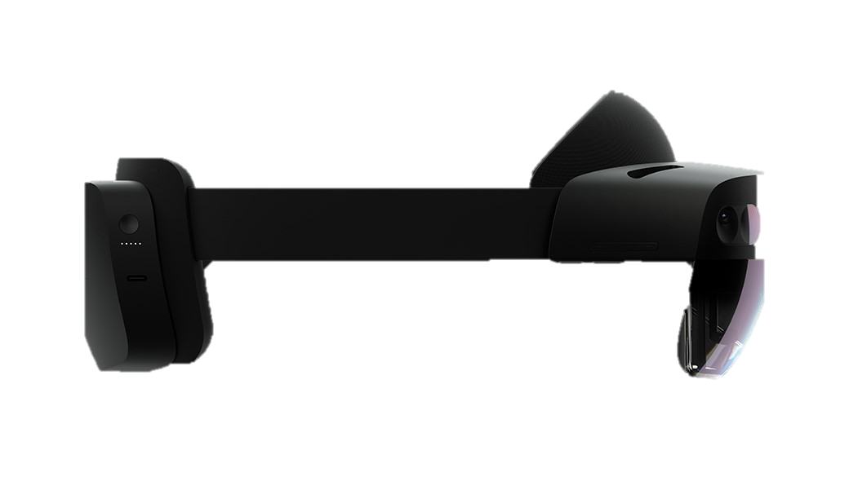
CT Registration using HoloLens 2
Geometric Image
Processing Lab
By: Nir Mualem and Oren Shavit
Supervisor: Amit Bracha, Ron Slossberg,
Yaron Honen

Slide 2
Problem Statement
During a sinus surgery, the surgeon needs to see the patient’s CT scan.
To make it more convenient, the CT scan will be displayed as a STL 3D file in the correct location using AR with Microsoft HoloLens 2.
The surgeon will be able to see the CT scans while looking at the patient during the operation.
Geometric Image
Processing Lab
Notes:
The GIP Framework goals are:
Being a simple as possible so that the overhead for learning to use it will be as low as possible.
Providing flexibility so that the user will be able to implement any algorithm and will not be drawn back by missing functionalities.
To answer the needs of the GIP researchers by providing UI utilities that are need for research and by attempting to support a wide type of image formats.
Providing a simple GUI for working on a batch of images or on a single image.

Slide 3
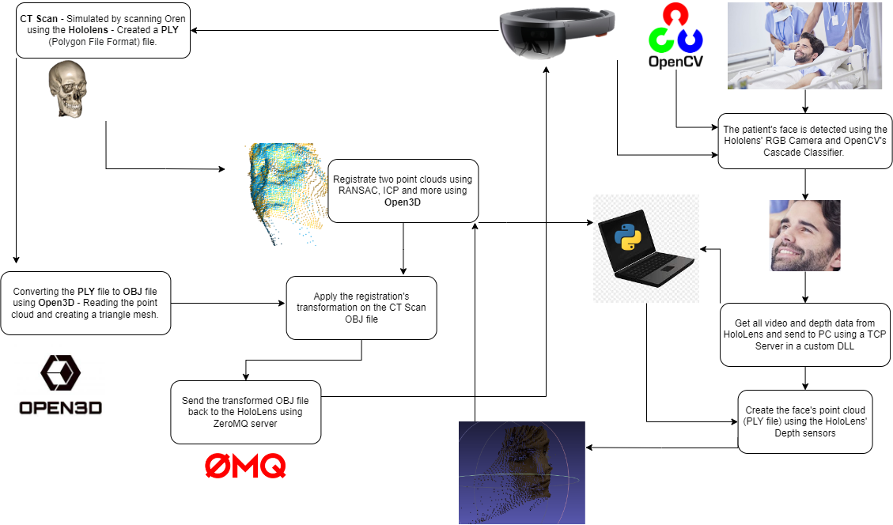

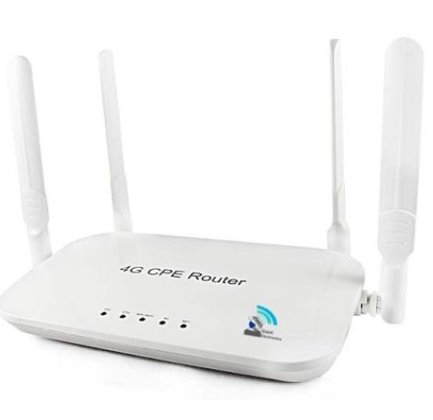
Flow Chart

Slide 4
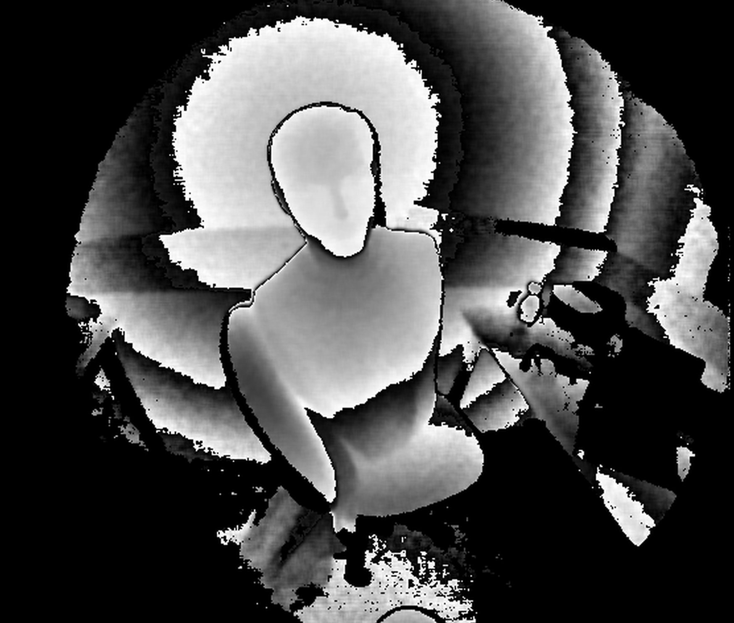
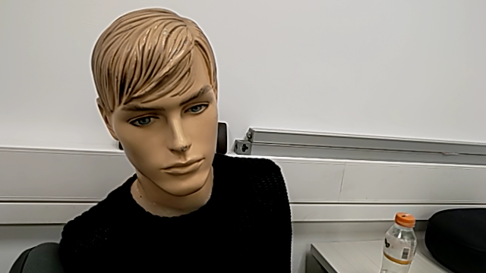
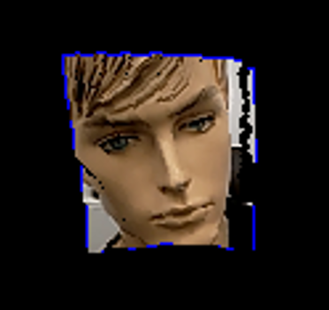
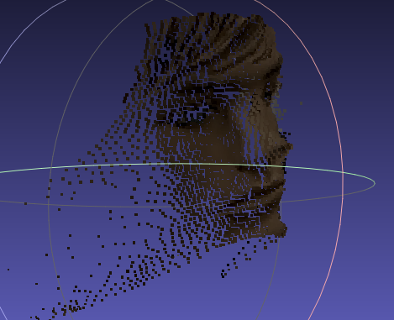
Live Streamer – Point Cloud
Depth -
AHAT Sensor
RGB
-
face detection and projecting on depth
Sensors
data
Face
Point Cloud

Slide 5

Registration Remote Server Registration Inputs
Face 1 –
Represent CT scan
Face 2 –
Live Stream

Slide 6
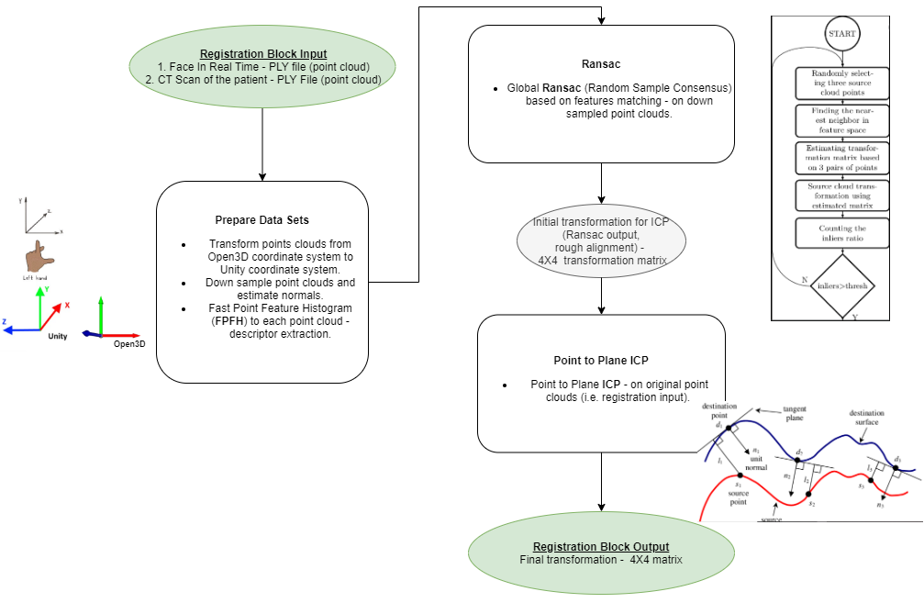
Registration Flow Chart

Slide 7
Registration – Main Algorithms
RANSAC - Random sample consensus
Iterative method for estimating parameters of a mathematical model from a set of observed data that contains outliers
In our work we are trying to estimate the transformation between the source (real time face) and the destination (the mathematical model, in this case is the CT scan).
ICP - Given a source surface and a destination surface, each iteration of the ICP algorithm first establishes a set of pair-correspondences between points in the source surface and points in the destination surfaces.

Slide 8
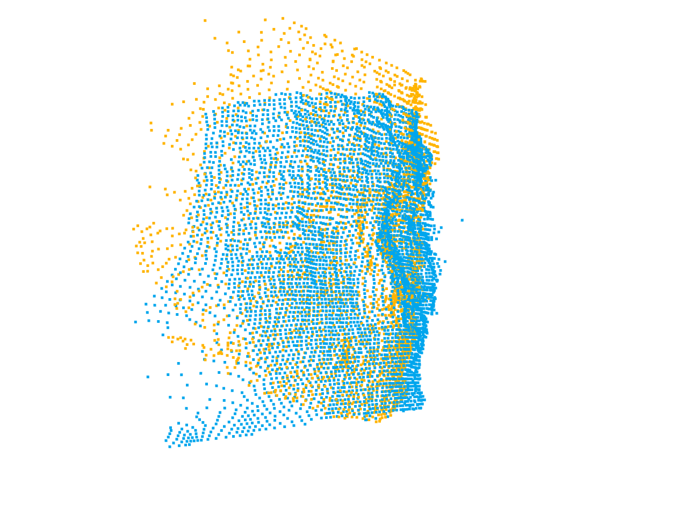
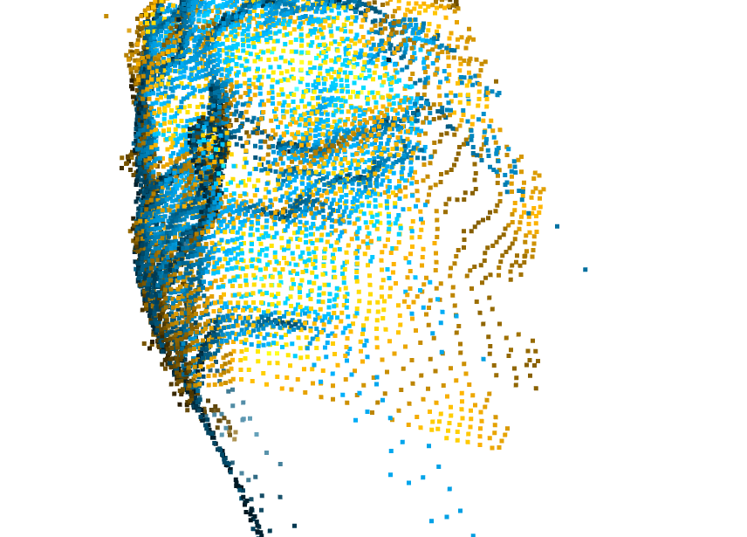
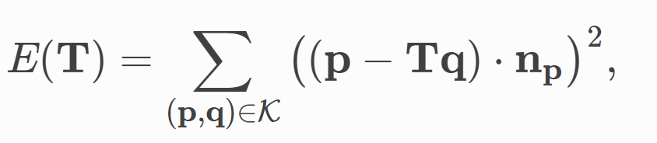
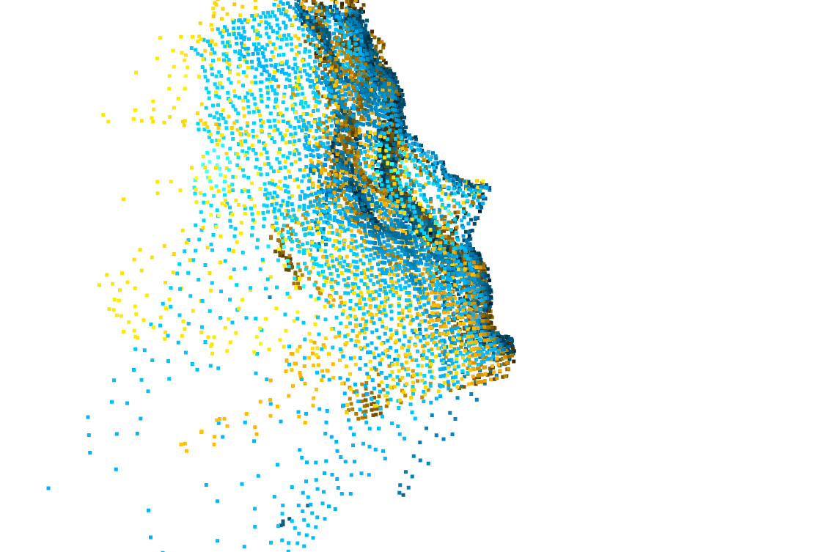
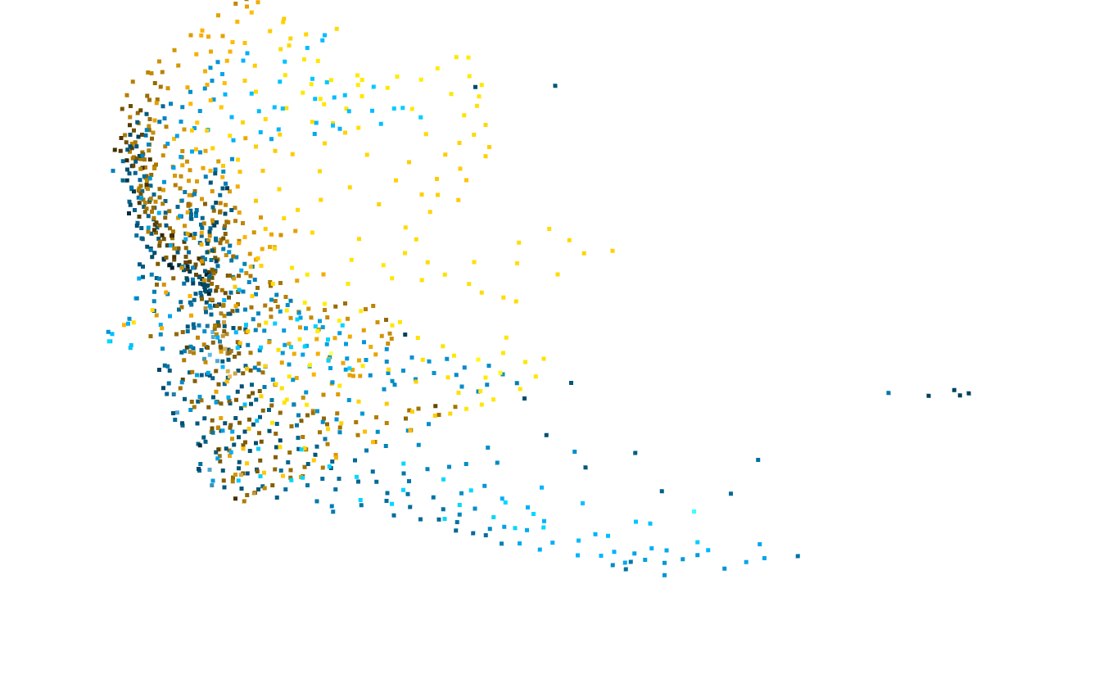
Registration Remote Server - Results
RANSAC transformation result is initial input for ICP
Point To Plane ICP results
First step-
RANSAC Algorithm
DownSamplePoints for RANSAC using feature matching (FPFH)

Slide 9
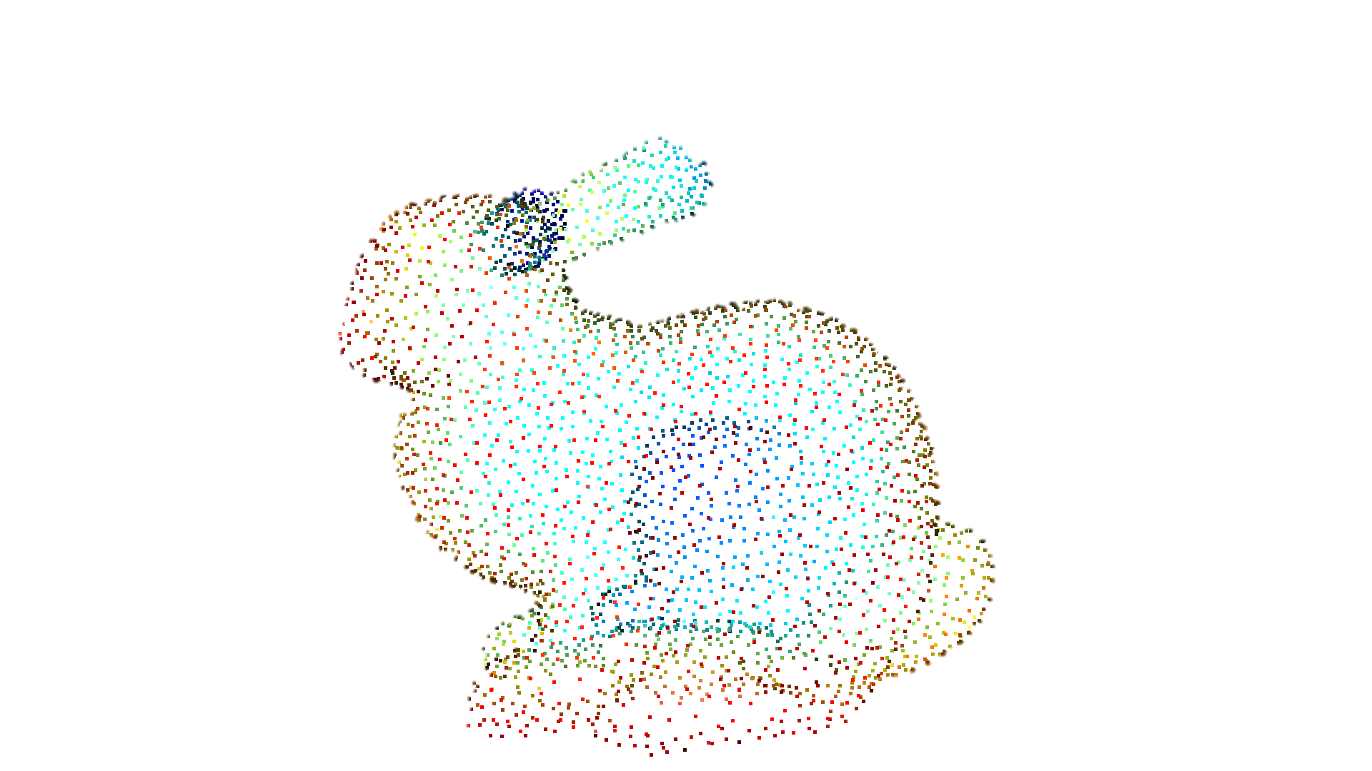
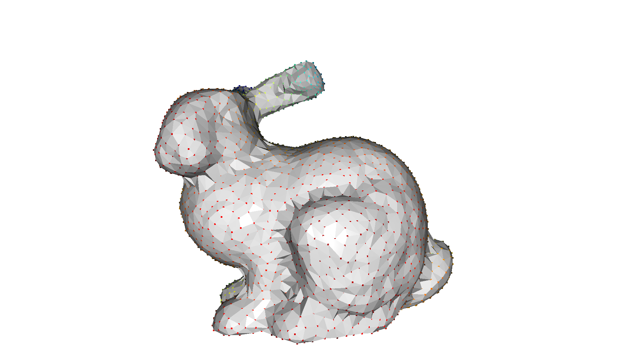
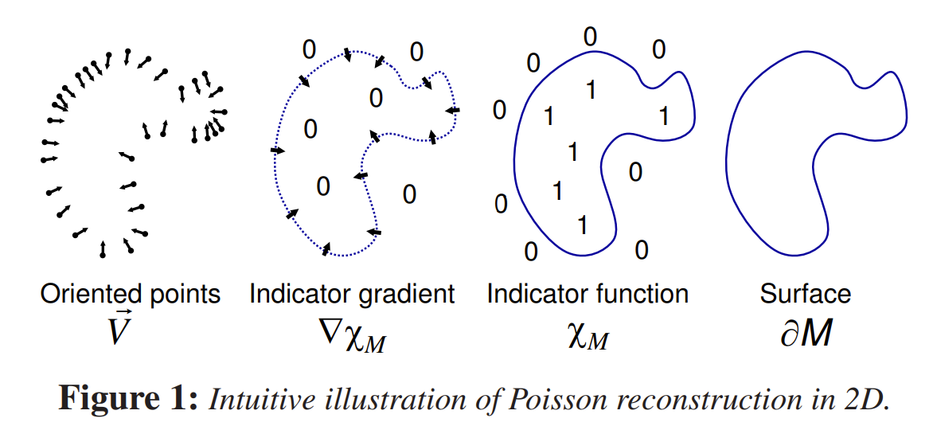
Surface Reconstruction From Point Cloud
Was needed in order to see the object in Unity and in Augmented Reality.
Read PLY file.
Estimate normals.
Orient normal towards camera location.
Use Poisson surface reconstruction.
Source: Open3D Link, Paper

Slide 10
Challenges & Solutions
Challenges | Solution
The transformation was incorrect in the Unity’s coordinates system | Applied the transformation on the object and sent the object using ZeroMQ.
Slow internet for sending data. | Used our own designated router.
Complex HoloLens sensors. | Chose AHAT depth sensor for short distance depth.
No good example CT scan model file. | Used the HoloLens to scan a face and create a model to be used as a CT scan.
HoloLens 2 is still developing and not very popular among many developers | Ongoing Google searching, GitHub

Slide 11
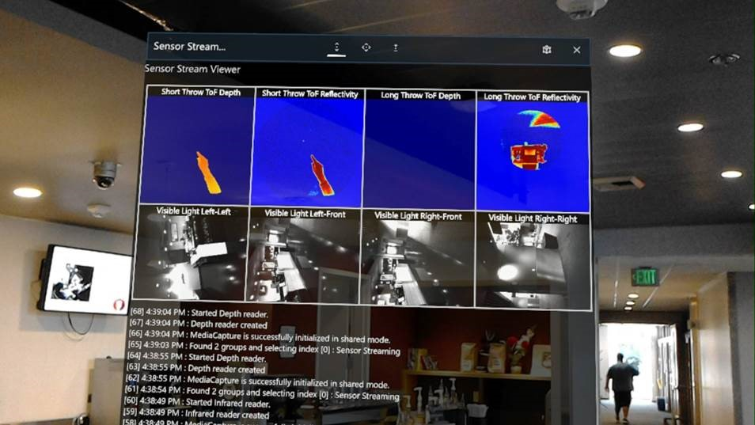
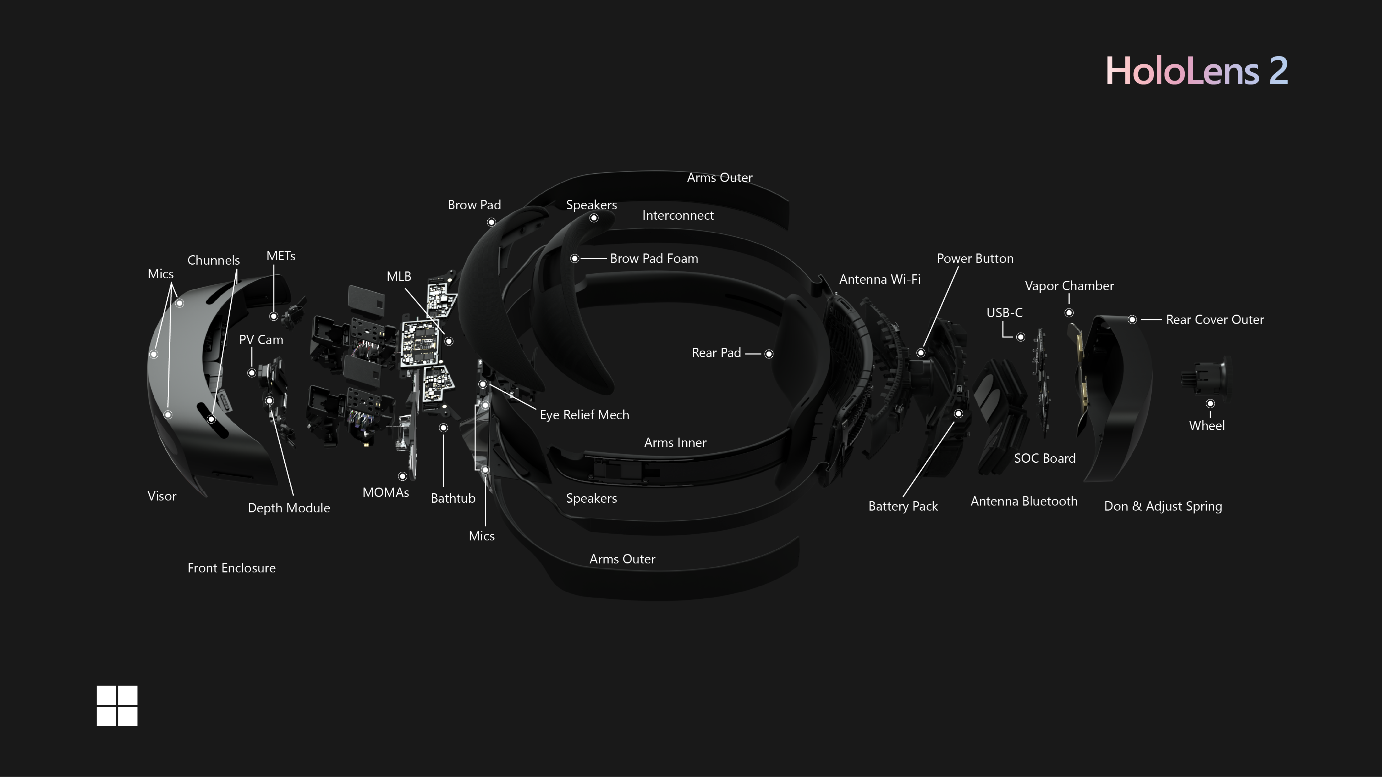
2

Slide 12
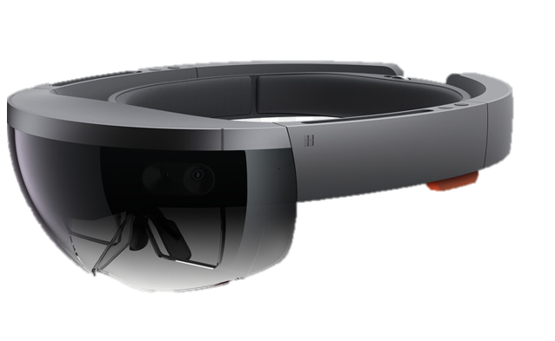



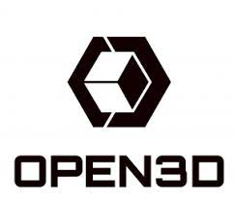

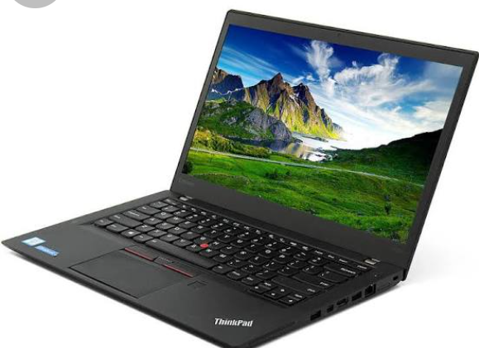
Tools & Devices
Microsoft HoloLens 2
Remote server on laptop (python scripts
Unity
OpenCV
Open3D
ZeroMQ
Mixed Reality Tool Kit
Router for communication

Slide 13
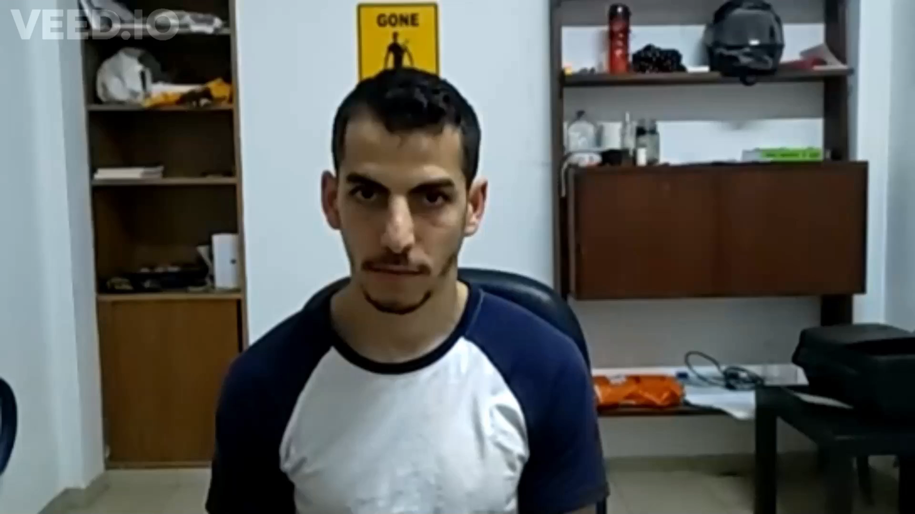
Demo

Slide 14
Future Work
Improve precision and correct location of the CT scan.
Perhaps coordinates system issues.
Improve performance – faster tracking.

Slide 15

GitHub Project
https://github.com/nir6760/HL2proj

Slide 16
Resources
Microsoft Mixed Reality Tool Kit
Developing for the HoloLens2 using Unity and Visual Studio
https://docs.microsoft.com/en-us/windows/mixed-reality/develop/unity/mrtk-getting-started
OpenCV
https://opencv.org/
ZeroMQ
https://tech.uqido.com/2020/09/29/zeromq-in-unity/
Global Registration
http://www.open3d.org/docs/release/tutorial/pipelines/global_registration.html
The Microsoft Git Repository: “HoloLens2ForCV”
For recording data from sensors using “research mode”.
https://github.com/microsoft/HoloLens2ForCV
Git Repository -Research Mode Streamer
https://github.com/cgsaxner/HoloLens2-Unity-ResearchModeStreamer
ICP Algorithm
https://en.wikipedia.org/wiki/Iterative_closest_point
http://www.open3d.org/docs/0.12.0/tutorial/pipelines/icp_registration.html
Notes:
The GIP Framework goals are:
Being a simple as possible so that the overhead for learning to use it will be as low as possible.
Providing flexibility so that the user will be able to implement any algorithm and will not be drawn back by missing functionalities.
To answer the needs of the GIP researchers by providing UI utilities that are need for research and by attempting to support a wide type of image formats.
Providing a simple GUI for working on a batch of images or on a single image.

